Slide 1
The Case for Inclusion: Disability Inclusion
Mostafa Attia, Disability Inclusion Expert, and Rebekah Martin, FCDO Disability Inclusion Helpdesk
December 2022
Notes:
The purpose of this presentation is:
To provide a brief overview of the scale of the barriers faced by disabled people in the Middle East and Africa (will also explore the intersectionality between gender and disability)
To start to identify possible entry points for promoting disability inclusion through FCDO’s existing work in the region.

Slide 2
Introducing disability inclusion
Notes:
What do you know about disability inclusion and your expertise
Their impressions and attitudes about PWD

Slide 3
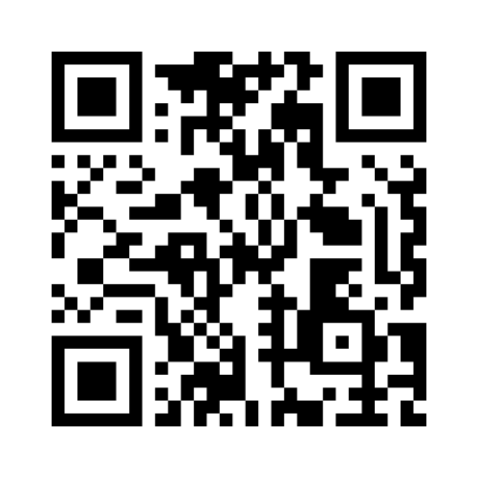
What thoughts, words and images come to mind when you think about disability?
Add your thoughts on Menti.com
Voting code: 1585 1196
Notes:
Rebekah to lead

Slide 4
Notes:
These are the words submitted during the session. We see a number of different perspectives emerging here, which are linked to the models of disability discussed on the next slide.
Some people have associations with particular types of impairment, such as people who use a wheelchair or autistic people. This can be an example of more of a medical approach to disability.
Other words, such as admiration or need can indicate more of a charity approach to disability.
Many people shared words such as barrier, equality and exclusion/inclusion. This is more of a human rights approach to disability.

Slide 5
Status of disability inclusion in MENA: September 2021
Disability from a rights perspective
The three predominant models of disability in use around the world today are:
The medical model (also known as individual approach);
The charity model (also known as individual approach);
The social / human rights model (also known as the inclusive approach).
Human rights approach (social model)
SOCIETY
People with disabilities
Explicit recognition of people with disabilities as a normal part of all social groups.
Rights based understanding
Focused on identifying barriers
Impairment + Barriers = Disability
Notes:
This slide should act as a recall / reminder to ensure we are always talking about disability from a rights/inclusion perspective not a medical/charity one. Key concept here is to ensure everyone working within PF can articulate this with confidence and feels able to challenge non-rights based thinking.

Slide 6
UN Convention on the Rights of Persons with Disabilities (2006)
‘…disability results from the interaction between persons with impairments and attitudinal and environmental barriers that hinders their full and effective participation in society, on an equal basis with others’
Source: CRPD Preamble (e)
Impairment + barriers = disability
Notes:
CRPD adopted in 2008 is the leading source for defining the scope and nature of disability inclusive development.
Ratified by 184 countries (2022)

Slide 7
Status of disability inclusion in MENA: September 2021
Disability remains a challenging issue in development programming
Disability from a rights perspective is still poorly understood in mainstream development;
Homogenisation of the experiences of people with disabilities.
Community stigma and negative attitudes
Lack of data on people with disabilities
General lack of documented experiences in relation to disability inclusion (knowledge gap)
Underestimation of the impact disability has on development outcomes at all levels

Slide 8
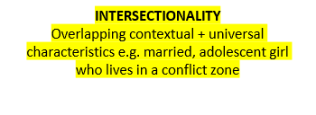
Barrier approach to disability inclusion
Identifying who is marginalized (individual factors)
Barriers to inclusion
LEVEL OF MARGINALISATION
OUTCOME
CONTEXTUAL FACTORS
Language
Geography
Caste/ class/ tribe
Ethnicity
Migration status
Security
Religion
Family status
Childbearing
Sexual orientation / sexual identity
ECONOMIC CONTEXT
PARTICIPATION
Economic
Improved basic needs
Decreased poverty
Improved resilience
Personal agency
Social
Family life
Health
Education
Social support & networks
UNIVERSAL FACTORS
Age (life stage)
Gender
Disability
Health status
ATTITUDINAL
Social norms (e.g. isolation, low self esteem)
Unconscious bias and assumptions (e.g. ‘cannot work’)
Fear of costs
Gender and age-related norms
ENVIRONMENTAL
Access to transport
Access to information
Access to workspaces and equipment
Access to finance
INSTITUTIONAL
Lack of inclusive education and training
Lack or ineffective anti-discrimination legislation
Limited knowledge / confidence amongst employers and providers on inclusive practice
Poor HR policies
C
U
Notes:
Important to note here that gender and disability inclusion can be approached in similar ways/simultaneously. E.g. through gender and disability disaggregated data, including OPDs and Women's Rights Organizations throughout planning, implementation, monitoring and evaluation. Avoid homogenization of experiences through good barrier analysis

Slide 9
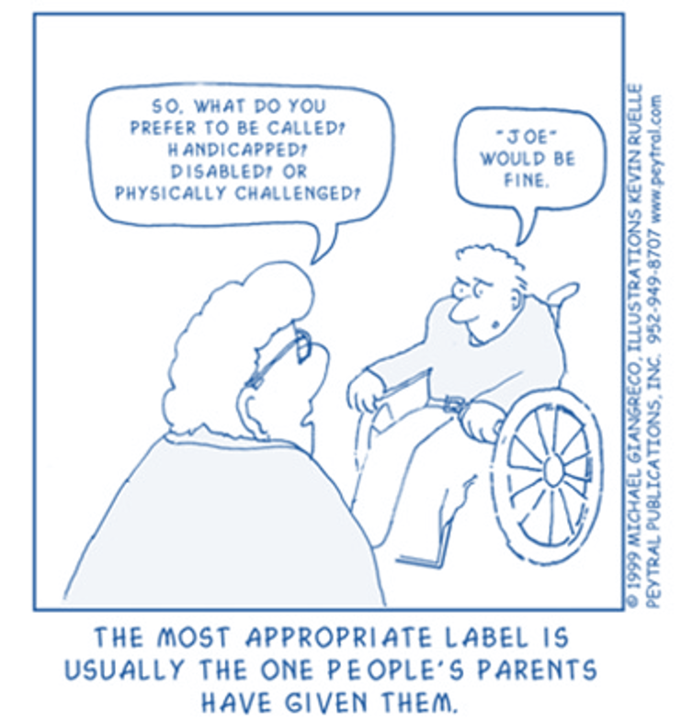
Inclusive Language
What to Say | What to Avoid
accessible parking or accommodations | handicap accessible
children with disabilities | special needs children
Deaf, hard of hearing (The uppercase “D” in “Deaf” is often used by people who culturally identify as Deaf) | dumb
non-disabled person, person without a disability | able-bodied, normal, whole
non-verbal or person who communicates non-verbally | mute
person with a congenital or developmental disability | deformed, person with a birth defect
person with an intellectual disability | slow, mentally retarded, dim-witted
person with a physical disability | crippled, handicapped, deformed, lame
person with a psychiatric or psychosocial disability or with a mental health condition | crazy, maniac, lunatic, moron, mad, demented, schizo, psycho, feeble-minded
Person who uses a wheelchair | wheelchair-bound, confined to a wheelchair
Notes:
Important to check what language people would like to use to refer to themselves

Slide 10
Disability Inclusion and FCDO

Slide 11
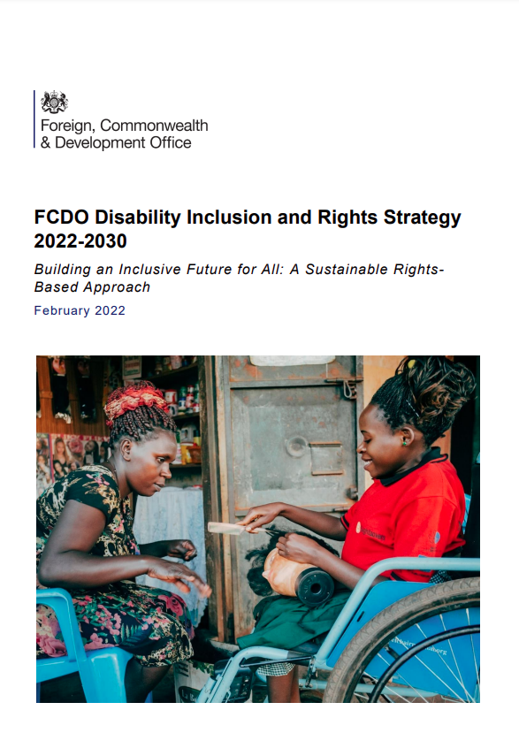
FCDO’s Disability Inclusion and Rights Strategy
The new strategic vision is a sustainable, inclusive and equitable future where:
“People with disabilities in all their diversity - including marginalised and under-represented groups - are meaningfully engaged, empowered and able to exercise and enjoy their full rights and freedoms on an equal basis with others, without discrimination and across the life-course. They are full and active members of society and decision-makers in all aspects of life, including diplomatic and development efforts.”
FCDO takes a human rights-based approach to disability inclusion, underpinned by the United Nations Convention on the Rights of Persons with Disabilities
Notes:
https://www.gov.uk/government/publications/fcdo-disability-inclusion-and-rights-strategy-2022-to-2030

Slide 12
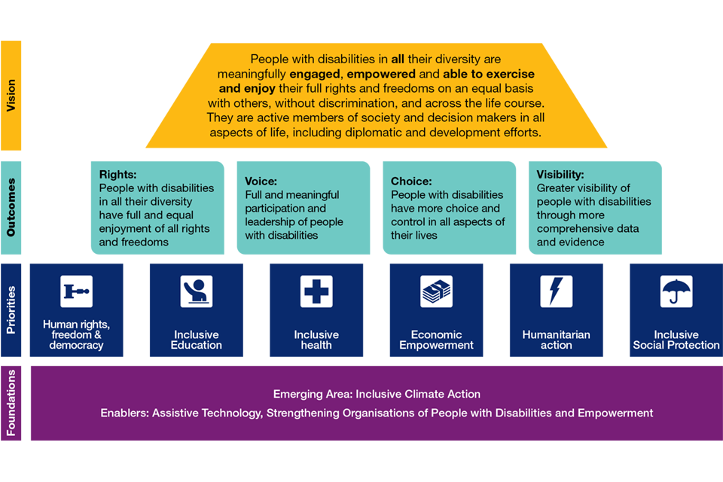
How FCDO plans to promote inclusion
Notes:
FCDO disability rights and inclusion theory of change summary
There are the four key outcomes that FCDO wants to see achieved in its work on disability:
Rights
Voice
Choice
Visibility
Aims
By 2030 embed disability inclusion across FCDO’s diplomacy, policy and programmes and OGDs UK Aid spend
Support a more powerful disability movement globally and at regional and country levels

Slide 13
What does this mean for FCDO posts and departments?
Minimum
Understand the barriers and existing inequalities
Safeguard people with disabilities
Start to engage with Organisations of Persons with Disabilities (OPDs)
Gather data on how many people with disabilities are reached
Analyse disability data and ensure conclusions are visible in reports
Raise awareness of disability inclusion
More
Include people with disabilities in GESI analyses, GESI strategy development and Equality Action Plans
Incorporate into visit programmes, events, comms, diptels
Invest in the capacity of OPDs

Slide 14
Meaningful engagement with Organisations of Persons with Disabilities (OPDs)
OPD capacity building, consultation and participation are key ‘enablers’ for inclusion.
Make connections with OPDs alongside other rights-based groups to understand the dynamics of the disability movement and their priorities via meaningful consultation.
Notes:
Consulting with OPDs is an obligation mandated for state parties of the UN Convention for the Rights of Persons with Disabilities (UN CRPD) in article 4.3. Working closely with civil society is part of the drive for localisation, referenced in the FCDO International Development Strategy 2022. FCDO also reflected the importance of OPDs in FCDO’s Disability Inclusion and Rights Strategy, where OPD capacity building, consultation and participation are key ‘enablers’ for inclusion
Consultation should not be seen as a one-off event, rather a springboard to developing an ongoing relationship between FCDO and civil society organisations. Consultation does not always have to be a formal meeting; surveys and electronic communications can also be used.
This will lead to:
More relevant, locally-owned and more effective interventions that will achieve better outcomes for persons with disabilities and society more generally
Engagement and empowerment of persons with disabilities.
When done well, meaningful participation helps to address stigma and discrimination against persons with disabilities
Greater accountability and transparency on FCDO activities and approaches to disability inclusion.

Slide 15
Middle East and North Africa
Selected insights regarding disability inclusion

Slide 16
Disability prevalence
Country | Disability prevalence (%)
Algeria | 5.5
Bahrain | 2.41
Egypt | 1.92 - 15
Iran | 1.3
Iraq | 0.9 - 8.4
Israel | 20
Jordan | 2.7 - 13
Kuwait | 4
Lebanon | 10 - 15
Libya | 2.9
Morocco | 5.07
Oman | 1.48
OPT | 2.1
Qatar | 0.19
Saudi Arabia | 1.91
Syria | 3 - 10
Tunisia | 1.22
Turkey | 12.29
United Arab Emirates | 20
Yemen | 2.17
WHO estimate of disability prevalence is 15% so it is likely that there is significant underreporting and people with disabilities may face barriers to state support.
Disability data across the region is both patchy and often dated.
Few countries apply the Washington Group questions (Egypt, Morocco, Tunisia) recognised as best practice for identifying people with disabilities. Pre-screening questions that may discourage reporting are also often used (Egypt and Tunisia).
Some disability data was collected pre-conflict (Libya, Syria), the prevalence of disability in conflict affected countries is likely to be higher.
Conflicted definitions of disability including types and models, particularly for psychosocial disabilities and mental health conditions
Notes:
Sources:
Algeria, Egypt, Libya, Morocco and Tunisia. Kalsi. K., and Attia M, Disability Inclusion Helpdesk Factsheet: Disability rights in North Africa and engaging with DPOs in the region (2020)
Bahrain 2010 census
Iran 2011 census
Iraq, IOM Iraq, Persons with disabilities and their representative organizations in Iraq: Barriers, Challenges and Priorities (2021)
Israel Social Survey 2020
Jordan, K4D, The current situation of persons with disabilities in Jordan (2018)
Kuwait, Public Authority for Disability Affairs 2022
Lebanon, K4D, Situation of persons with disabilities in Lebanon (2018)
Oman census 2010
OPT, Press_En_3-12-2019-dis-en.pdf (pcbs.gov.ps)
Qatar census 2007
Saudi Arabia demographic and health survey 2016
Syria, K4D, Disability in Syria (2017)
Turkey, Turkish Survey into Persons with Disabilities, Department of Persons with Disabilities, Prime Ministry, Turkish Statistics Institute, 2002
United Arab Emirates Dubai Health Authority 2012
Yemen, household budget survey 2014

Slide 17
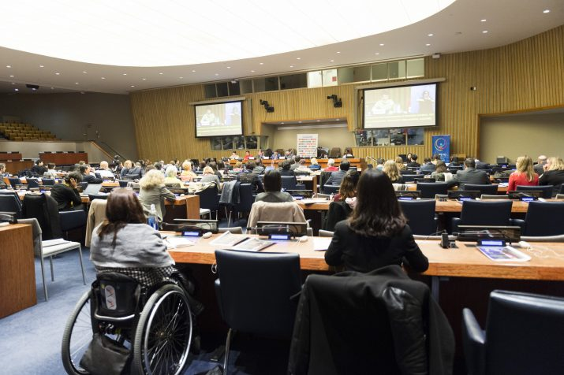
Where is there political will and progress - CRPD?
Country | CRPD ratification | CRPD Optional Protocol
Algeria | 2009 | 2007(s)
Bahrain | 2007 | 2011
Egypt | 2008 | -
Iran | 2009 | -
Iraq | 2013 | -
Israel | 2012 | -
Jordan | 2008 | 2007(s)
Kuwait | 2013 | -
Lebanon | - | -
Libya | 2018 | -
Morocco | 2009 | 2009
Oman | 2009 | -
OPT | 2014 | 2019
Qatar | 2008 | -
Saudi Arabia | 2008 | 2008
Syria | 2009 | 2009
Tunisia | 2008 | 2008
Turkey | 2009 | 2015
United Arab Emirates | 2010 | -
Yemen | 2009 | 2008(s)
Notes:
CRPD
Lebanon is the only MENA country not to have ratified the CRPD, 10 have ratified the Optional Protocol.
The Optional Protocol allows persons with disabilities whose rights have been violated to bring complaints to the Committee on the Rights of people with disabilities

Slide 18
Status of disability inclusion in MENA: September 2022
Opportunities and mobilizers following the ratification of the CRPD and the Arab uprising
Many countries declared new disability inclusion policies in compliance with the UNCRPD and the SDGs within the last decade
Adherence to the disability mainstreaming concept within some MENA region constitutions.
Increased funding of various international organisations to support the inclusivity and efficiency of services for people with disabilities in their communities or to mainstream disability inclusion in other public services.

Slide 19
Status of disability inclusion in relation to the MENA strategy
Prosperity
Societal resilience
Security and stability
Environmental | Attitudinal | Institutional
Lack of national disability and inclusion strategies. Lack of accessible infrastructure, including transport, offices, public buildings and schools. Lack of inclusive education materials. Lack of accessible information, including of available services. Limited coverage of inclusive or disability-specific services in remote and marginalised areas. | Existing gaps between people with disabilities and service providers which hinders access to opportunities. Stigma and discrimination among service providers and employers. Lack of awareness of disability rights, including among persons with disabilities. Risk of violence and abuse; most cases committed by family members. | Outdated and/ or contradictory legislation. Poor ministerial oversight, including limited strategies, policies and data. Poor monitoring mechanisms and/ or enforcement of legislation. Lack of coordination between responsible Ministries/ agencies. Lack of consultation with persons with disabilities.
Notes:
Shows some common barriers across the MENA region that impact the 3 pillars in the MENA strategy.
For the consultation of people with disabilities: Point to the organisations working in the region =
The Disability Monitor Initiative – Middle East (DMI) active in Lebanon, Egypt, West Bank/Gaza, Jordan, Syria, Iraq and Yemen.
The Arab Organisation of Persons with Disabilities (AOPD)
Disabled Peoples International
The DID Helpdesk's report on how OPDs have been affected by the pandemic in Nigeria, Zimbabwe and Bangladesh showed the lack of engagement between governments and OPDs before and during the pandemic had severe knock on effects. OPDs stepped in to provide for basic needs where governments failed, and they had to shift their advocacy from long-term improvements to policies to immediate issues aggravated by the pandemic.
https://sddirect.org.uk/resource/consequences-exclusion-situation-report-organisations-people-disabilities-and-covid-19

Slide 20
Status of disability inclusion in relation to the MENA strategy
Prosperity
Societal resilience
Security and stability
Infrastructure and transport:
‘Even when transport is available and persons with disabilities are able to pay, almost all of the transport is inaccessible to people who have visual impairments, use a wheelchair or have other disabilities; information that is easy to read for persons with learning disabilities is also absent…. Independent travel it seems, for persons with disabilities in the Middle East is extremely difficult and many times impossible.’
Employment:
High unemployment rates despite employment quotas.
Poor legislation and/ or enforcement is facilitating employment discrimination.
Disability-targeted vocational training and small loans.
Notes:
First point:
Adults with disabilities (and especially women with disabilities) have less access to employment opportunities than their peers without disabilities.
Many countries have quotas for people with disabilities in employment in the public and private sector: Morocco, 7%, Egypt, 5%, Tunisia, 2%, Algeria, 1%. Employment rates of people with disabilities, particularly women with disabilities, are very low, even where there are mandatory employment quotas in place. Quota’s are typically not enforced, e.g. employers in Egypt reported to have people with disabilities on their payroll and don’t employ them.
Second point:
In Libya people with disabilities are often assessed for work based on their physical ability rather than their qualifications, experience, and interests.
In Egypt, reports of formal-sector employers paying persons with disabilities below the minimum wage.
Third point:
Iraqi government has tried to establish technical support from international organisations to assist people with disabilities to acquire vocational skills. The Community Rehabilitation Fund has established low interest loans for self-employment opportunities of disabled people.
In Jordan, the Development and Employment Fund provides loans to persons with disabilities. people with disabilities are only required to pay 25% of the fees of courses in public universities.
In contrast, Lebanon’s National Employment Office has promoted specialised centres and workshops for people with disabilities to work in segregated workplaces. Not aligned with the CRPD
Infrastructure and transport:
Quote from 2009 Disability Monitor Report for the Middle East. …. One positive example from the region: In Turkey, planning for accessibility in construction plans, urban, social and technical infrastructure plans and buildings is a legal requirement in Turkey.

Slide 21
Status of disability inclusion in relation to the MENA strategy
Prosperity
Societal resilience
Security and stability
Inclusive education:
Morocco; moving from segregated schools to mainstream education.
Iraq; national inclusive education framework.
Political participation:
In Libya, 2012 General National Congress polling stations were not accessible. 2014 elections of the House of Representatives, had 165 polling stations equipped for persons with disabilities.
In Egypt, the 2014 Constitution necessitates representation in the parliament, as a result 8 MPs with disabilities were appointed in the 2015 parliament
Inclusive health services
Broadly of poor quality and not CRPD aligned, despite government and NGOs
Notes:
Could address so much. Will focus on two areas instead:
Education:
Considerable problems persist around segregation in the region. In Lebanon, there are reports of children with disabilities being excluded from public schools due to discriminatory admission policies, lack of reasonable accommodations, a shortage of sufficiently trained staff, lack of inclusive curricula and discriminatory fees and expenses that further marginalize children with disabilities from poor families. Stigma, family reluctance and school resistance remain. Children with disabilities in MENA region are frequently not in mainstream schools and/ or rarely attend school past secondary level. There are some promising examples:
Morocco: In 2017, the majority of children with disabilities attend segregated schools rather than being included in the mainstream education system (CRPD, 2017). In June 2019, the Ministry of National Education and Vocational Training launched a national inclusive education programme, primarily aimed at supporting children with disabilities.
Iraq: In 2018, in collaboration with the European Union and the British Council, the Government of Iraq worked on a national framework to develop equal and inclusive education, which also involved working towards integrating special needs education into its already existing government public schools. This process entails equipping the schools, preparing the necessary curricular and teaching materials and training teachers and supervisors.
Tunisia and Jordan, has also progressed on polling stations accessibility and representation in the parliament
Inclusive health:
In Egypt: people with disabilities do not have full access to basic services which hinders their full inclusion in society, health and rehabilitation services available in Egypt for children and adults with disabilities were lacking, of poor quality, and did not meet all the needs of people with disabilities. NGOs and faith-based charities also provide social and health services for people with disabilities, generally following the charity approach rather than the rights-based approach.

Slide 22
Status of disability inclusion in relation to the MENA strategy
Prosperity
Societal resilience
Security and stability
Conflict/ fragile settings and disability:
Instability increases disability prevalence.
The impact of instability is also greater on persons with disabilities.
Disaster Risk Reduction (DRR) strategies
National strategies lacks consideration of the rights and demands of people with disabilities
Voices of people with disabilities are not heard enough during DRR planning process
Climate change is a ‘threat multiplier’:
People with disabilities are at particular risk of the impacts of climate change, not because of inherent vulnerabilities, but because of less resilience to its impacts.
Requires Disability Inclusive Climate Adaptation and Disaster Risk Reduction
COVID-19 is a compounding factor:
Persons with disabilities are at greater risk from COVID.
Disproportionate impact of non-health related risk.
Notes:
Point 1:
Persistent political instability, conflict and economic inequality in the MENA region has increased the incidence of all disabilities, including mental health conditions from psychological stress (World Bank, 2005).
There is a high prevalence of disability among internally displaced persons and refugee populations. Syrian and Palestinian refugees in Lebanon show high prevalence rates of anxiety, depression and post traumatic stress. In 2014 it was estimated that 154,000 of 700,000 refugees in Jordan were people with disabilities (22%).
Point 2:
Amnesty International has documented difficulties of people with disabilities in fleeing conflict in Yemen, cases of people with psychosocial disabilities being unable to flee because they were chained, people with disabilities being left behind as their families fled, difficulties in accessing essential services and aid, and increased economic hardship of displaced people with disabilities in Yemen.
Point 4:
Iraq has recently begun a three year process with UN Environment Programme (UNEP) to develop a National Adaptation Plan (NAP) to build the country’s resilience to climate change. The Green Climate Fund (GCF) climate change adaptation planning project in Iraq aims to include people with disabilities .
Point 5:
Of contracting COVID-19
More likely to develop serious illness from COVID-19
Some mental health conditions and psychosocial impairments could be exacerbated due to fear and anxiety over contracting COVID-19, and because of economic pressures or social isolation.
Point 6:
A recent report found that the main protection issues affecting people with disabilities in Syria as a result of the pandemic are: lack of access to services(69%); stigmatisation, marginalisation and discrimination (50%); violence, abuse or neglect within families/households (39%); lack of access to information, including due to communication barriers (37%); and separation from family/household members/caregivers (23%).
Additional resources:
Disability Inclusion Among Refugees in the Middle East and North Africa https://www.irex.org/sites/default/files/pdf/disability-inclusion-refugees-middle-east-north-africa.pdf

Slide 23
Intersection of gender and disability
Women with disabilities face more marginalization and violence
In Lebanon women with disabilities experience more verbal abuse than other women, respondents also believe that women with disabilities experience more physical violence than women without disabilities (Sayrafi, 2013).
In Syria - girls and women with disabilities were at high risk of violence, including physical, emotional, and sexual violence, and exclusion from education and other services (UNFPA, 2021)
In Gaza, GBV services reportedly fail to consider women with disabilities, including a lack of clear strategies to mainstream disability in emergency plans and a lack of accessible information and services (Fraser et al, 2017).
Unequal access to access to education and employment opportunities
In Gaza, women with disabilities and those with intellectual disabilities are disproportionately excluded from training and work initiatives, including women survivors of GBV (Humanity & Inclusion, 2019).
Absence of disaggregated data about disability and gender
Notes:
While global research has found that women with disabilities, and especially those with intellectual disabilities are particularly vulnerable to violence (Hughes et al, 2012), there appears to be few studies documenting the prevalence and experiences of violence against women and girls with disabilities in MENA, including how these experiences changes in the context of conflict and insecurity.
Evidence includes:
Higher risk of violence (e.g Syria/ Gaza and Lebanon)====== because of exclusion and negative attitudes (e.g. Jordan and Gaza – HI)=====little access to services (e.g. Fraser et al)

Slide 24
National legislation and policy?
Country | National legislation
Algeria | Non-discrimination legislation and state obliged to promote equal access to vocational training, but not effectively enforced.
Egypt | 2014 Constitution mainstreams rights of persons with disabilities. Parliament, 8 seats reserved for MPs with disabilities. 2018 law recognises rights, covering housing, employment, education and health insurance etc.
Iran | 2018 Law to Protect the Rights of the Disabled. Criticised for being unenforced and following a charity model approach and containing discriminatory language
Iraq | Law No.22 on Persons with Disabilities and Special Needs (2011); Law No.38 on Welfare of disabled people (2013). Poor implementation. 2017, 60billion Dinars allocated to welfare of persons with disabilities.
Jordan | Updated 2017 Disabled People’s Rights Act (No. 20) includes anti-discrimination principles and a commitment to making all public facilities accessible within 10 years. Established a Higher Council for Persons with Disabilities as an independent national institution responsible for policy-making and planning for disability inclusion.
Lebanon | Lebanon introduced Law 220/2000 on the rights of persons with disabilities (2000) emphasises the rights of persons with disabilities, but criticised for entrenching segregated services (e.g. segregated psychiatric wards, live-in rehabilitation centres, and segregated schools).
Libya | No new disability law to comply with the CRPD principles, currently uses the 1987 Law no. 5.
Morocco | Framework Law 97-13 (2016) sought to harmonise legislation with the CRPD, but law emphasises diagnosis and prevention rather than participation and inclusion of people with disabilities. Concerns exist that the law fails to clarify legal capacity and fails to guarantee access to inclusive education.
Notes:
Some examples from different MENA countries
National legislation
The majority of MENA countries have included articles on disability in their constitutions.
Legal provisions pertaining to the employment for persons with disabilities are prevalent throughout the MENA region. Several countries (including Egypt, Lebanon and Tunisia) have instituted employment quotas for persons with disabilities (ranging from 1 to 5%), mainly in the public sector, but also, increasingly, in the private sector.
Point to Egypt (prompted by the Arab Spring), Jordan and Tunisia (the result of strong advocacy and the Arab Spring), perhaps ‘good’ examples in the region.
Point to Libya, an example where there is much still to do.

Slide 25
National legislation and policy?
Country | National legislation
OPT | Palestinian Disability Law No. 4 affirms the rights of disabled people to equality before the law, non-discrimination, housing, health care, travel, work, participation in cultural life and sport. National plans for rehabilitation of disabled people have been produced, which have been financed by the World Bank, but implementation has been limited.
Syria | National Disability Law No. 34 (2004). Damascus approved to become first accessible governorate in Syria (pre-crisis) Registration system for persons with disabilities created by Ministry of Social Affairs and Labor in Syria MoSAL
Tunisia | Tunisian National Charter on the Rights of persons with disabilities changed discourse to a human rights perspective. 2014 Constitution (following Arab Spring), aligned with CRPD.
Turkey | Turkish Disability Act (2014) reaffirms the rights of disabled people in line with the CRPD. In 2020, Turkey was drafting the “National Strategy Document and Action Plan on the Rights of Persons with Disabilities” to plan practical measures to implement the CRPD.
Yemen | National disability strategy affirms its commitment to the rights of disabled people Social Welfare Fund and Handicapped Welfare and Rehabilitation Fund, however ongoing armed conflict has affected implementation. Ministry for Social Affairs and Labour mandated to develop a national awareness raising plan in order to enable their participation in society on an equal basis with others, but current legislation (Law No. 5, 1991) contravenes the CRPD as it does not take a rights-based approach.
Notes:
National legislation
Point to Tunisia (the result of strong advocacy and the Arab Spring)

Slide 26
Inclusive Workplace Practices

Slide 27
Examples of barriers in the workplace
Environmental barriers
Accessibility audits
Institutional barriers
Recruitment processes
Retention and promotion policies
Reasonable adjustment policy
Attitudinal barriers
Staff awareness
Support to managers
Communication materials
Universal Design approaches
Communication practices
Work practices

Slide 28
Disability etiquette
Individuals with mobility impairments
Do not touch a person’s mobility equipment
Be sensitive about physical contact in consideration of possible pain, balance, or post-traumatic stress issues
Always direct your conversation that is meant for the person with a disability to them and not to their personal assistant, interpreter, companion or colleague
If convenient and natural, put yourself at the person’s eye level when engaging in a conversation; rather than kneeling, pull up a chair
Individuals who are blind or have low vision
Identify yourself when approaching the person or entering an ongoing conversation; announce when you leave the conversation or the room
When serving as a sighted guide, offer your arm or shoulder rather than grabbing the person’s arm or pushing the person from the back
Describe the setting, environment, and obstacles when serving as a sighted guide
Offer to read the information if the occasion naturally arises such as during a roundtable or a meal

Slide 29
Individuals who are Deaf or Hard of Hearing
Gain the person’s attention before starting a conversation (e.g., tap the person gently on the shoulder or arm or by a hand signal)
If the individual uses a sign language interpreter, speak directly to the person, not the interpreter; keep your eyes on the individual and not on the interpreter, especially when the interpreter is voicing for the person who is deaf
Face the person, speak in normal tones, and avoid the instinct to shout
Individuals who have Speech Impairments
If you do not understand what the person is saying, ask the person to repeat what they said and then repeat it back to ensure you understood
Do not speak for the person or attempt to finish their sentences
If the conversation is not working, explain that and ask if you can try with writing (e.g. electronic communication devices, paper and pencil, etc.)
Individuals who have intellectual disabilities
Speak directly to the person and respect their expressed preferences as to choices or decisions.
When in a public area with many distractions, consider moving to a quiet location.
Be aware of the possible need to speak to the person in clear and short sentences. Repeat your information and your questions, as needed. Use concrete words and visual aids or color-based cues.
Present information in Easy Read formats.

Slide 30
Questions
Notes:
Answers to questions asked in the session can be found in the attached document.

Slide 31
Thank you!
For more information see the Disability Inclusion Helpdesk website:
www.sddirect.org.uk/project/disability-inclusion-helpdesk
Or email: enquiries@disabilityinclusion.org.uk

