Slide 1
DGMF and Disability Rights discussion
June 2021

Slide 2
Gender and Equalities Department
Progressing gender equality, tackling exclusion and discrimination, ensuring no one is left behind
Gender equality
Disability inclusion
Social protection
Inclusion/ LNOB policy
Violence against women and girls
Child protection
LGBT

Slide 3
What do we mean by disability?
“Disability is an evolving concept that results from the interaction between persons with impairments and attitudinal and environmental barriers that hinders their full and effective participation in society on an equal basis with others.”
- Preamble UNCRPD
Facts and Stats?
1 billion people (15%) globally have a disability
50% of children with disabilities out of school (before pandemic)
60% of C-19 deaths in UK were disabled people
34% of FCDO programmes have some activity on disability.

Slide 4
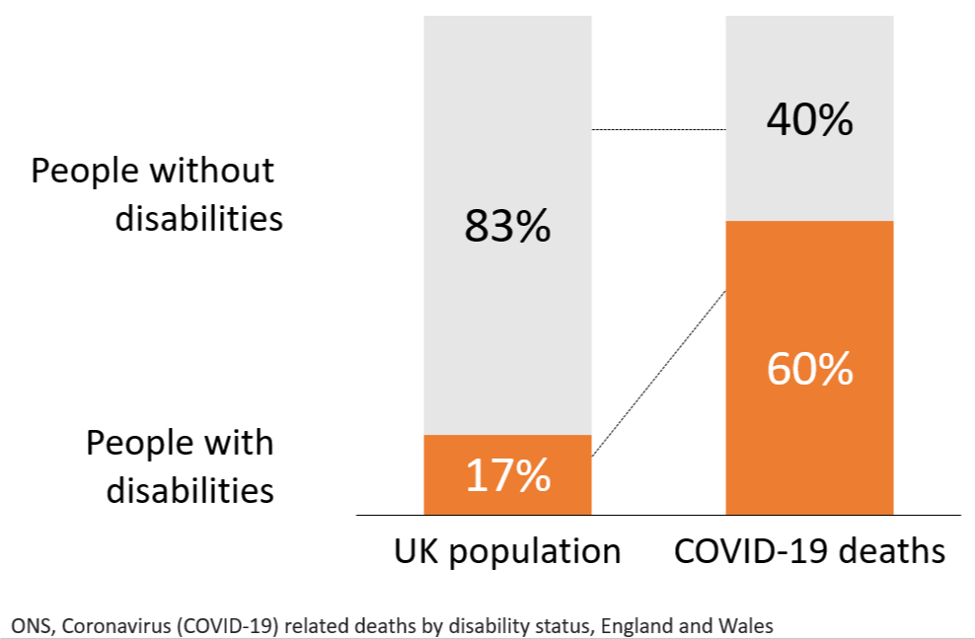
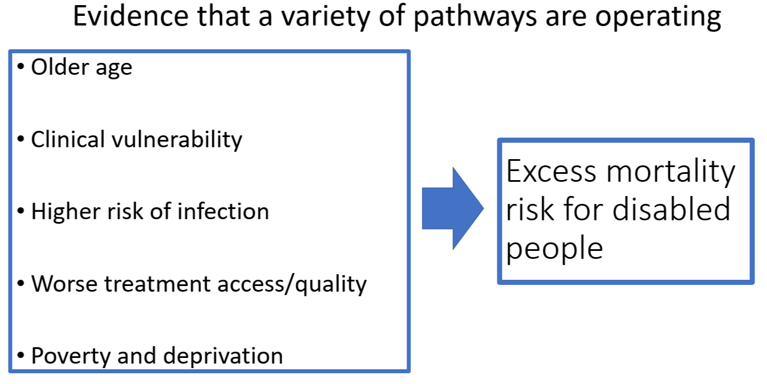
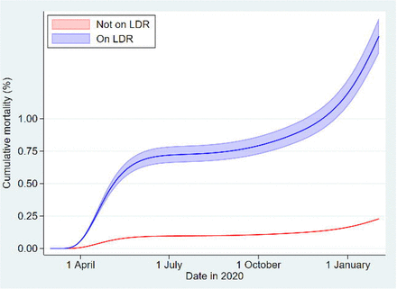
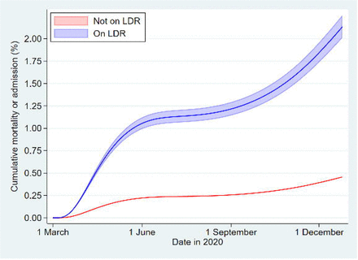
COVID-19 mortality hospitalization

Slide 5
Models of disability – 1
Medical model of disability
Focus on ‘fixing’ or ‘curing’ individual impairments
Disability is within the individual
Example: a child is born deaf and is given a cochlear implant at the age of two

Slide 6
Models of disability – 2
Charity/welfare model of disability
Focus on perceived individual limitations
People with disabilities seen as victims needing care and protection
Example: a child is born deaf and people assume they will never be able to attend school like “normal” children

Slide 7
Models of disability – 3
Social model of disability
Focus on removing barriers in society
“It is society which disables physically impaired people. Disability is something imposed on top of our impairments.”
Vic Finkelstein (UPIAS, 1975)
Disability movement: “Nothing about us without us”
Example: a qualified Deaf woman doesn’t get a job because employers are not willing to provide reasonable accommodations (e.g. sign language interpretation)

Slide 8
Models of disability – 4
Human rights model of disability
Focus on inalienable human rights
Disability is seen as a natural and common aspect of the human experience
People with disabilities are seen as rights-holders
Example: a child is born deaf, and their right to health care, social inclusion and education must be guaranteed

Slide 9
United Nations’ Convention on the Rights of Persons with Disabilities (UN CRPD) (2006)
Paradigm shift
Persons with disabilities are not viewed as "objects" of charity, medical treatment and social protection; rather as "subjects" with rights, who are capable of claiming those rights and making decisions for their lives based on their free and informed consent as well as being active members of society.

Slide 10
Multiple Dimensions of Discrimination
Disability stigma and discrimination interacts with other structural factors such as racism to compound peoples experience of poverty.
Certain groups are more likely to have a disability than the general population, including older people, women, indigenous people and children from ethnic minority groups*.
Women with disabilities are more likely to be poor, unemployed, live in food-insecure households and have lower levels of education than men with disabilities**. They are also 2-4 times more likely to experience intimate partner violence than women without disabilities.
Prevalence of disability is often higher in conflict and humanitarian settings. For example 1 in 5 Syrian refugees in Jordan and Lebanon has a disability and refugee children with disabilities were less likely to enrol in and attend school regularly.
Notes:
References:
* (WHO 2011 and UN (2009) The State of the World’s Indigenous Peoples);
** (WHO, 2011, cited in Gender and Development Network (2020) The intersection of gender and disability: A primer for international development practitioners on women and girls with disabilities and UNDESA 2018).
*** (Hosseinpoor, A. R., Bergen, N., Kostanjsek, N., Kowal, P., Officer, A. and S. Chatterji (2016) “Socio-demographic patterns of disability among older adult populations of low-income and middle-income countries: results from World Health Survey” in International Journal of Public Health, vol. 61. Measures included different levels of education, including completion of primary, secondary, as well as income expressed in quintiles, ownership of assets..)
**** (Blyth, J., Alexander, K. and Woolf, L. (2020) Out of the Margins: An intersectional analysis of disability and diverse sexual orientation, gender identity, expression & sex characteristics in humanitarian and development contexts, Edge Effect)

Slide 11
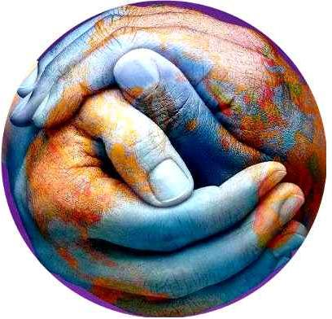
Inclusive development
4 key principles:
Participation
Non-discrimination
Comprehensive accessibility
Autonomy and self-determination
Twin-Track approach:
Actions to mainstream disability in all programmes
Actions specifically targeting people with disabilities

Slide 12
FCDO: where are we on the continuum of disability inclusive diplomacy & development?…
Minimum
Do no harm
Medium
Empower
High
Transform
Interventions not aimed at socially marginalised groups, but take active steps to do no harm and do not reinforce inequalities, comply with legislation
Active steps to address diverse needs of people with disabiltiies, protect their rights, and address barriers
Leadership role - targeted policies and interventions promote the position of people with disabilities, ODA and non-ODA spend adopts equality focus
Africa Strategy’s “Inclusive Principles” with Debbie Palmer and Simon Mustard as SROs monitoring progress on equalities targets
FCDO Philippines are the first stage of the journey: developed a factsheet/situational analysis, meeting disability rights movements and training for staff
Nigeria Inclusion Analysis and Equalities Action Plan
FCDO Ghana: Targeted Disability Rights Diplomacy and Development (Leave No One Behind £39m)

Slide 13
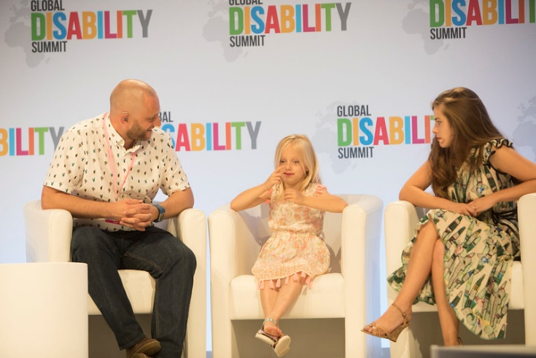
High Level Moments on Disability Rights
UK’s National Strategy for Disabled People (June)
PM “most ambitious initiative for disabled people in a generation”
FS “wants FCDO to play a full role on inclusion, particularly disability”
UN Conference of State Parties (COSP)
COSP to the Convention on the Rights of Persons with Disabilities
Paralympics & campaign #Weare15
Starting with Paralympics and a high level meeting 5 Sept
2nd Global Disability Summit in Oslo February 2022
US Summit for Democracy

Slide 14
Mapping the linkages between DGMF and disability rights?
UNCRPD compliant policy, standards, administrative and legislative provisions in place and inclusive, accountable and transparent governance e.g.
Repeal discriminatory legislation, bring policy and legislation in line with UNCRPD, national action plans
Transparent resource mobilisation, inclusive budget processes
Strengthen institutions including capacity of National Human Rights Institutions/ National Disability Commissions
Effective and full participation of people with disabilities
Political empowerment and disability inclusive electoral cycles – address systematic barriers including discriminatory legislation, accessible infrastructure, election materials and voting processes
Capacity building of organisations of persons with disabilities
Support for coalition building between disability rights movements and mainstream human rights defenders/ civil society
Tackling norms and harmful practices
Representation and accessible formats in media and cultural institutions, training for journalists embeds non discrimination
Programming and political dialogue to address root causes of stigma & discrimination involving traditional &community leaders
Ensure existing and new legislation, policies and implementation strategies prevent and address torture, exploitation, violence, coercion, abuse and neglect against persons with disabilities by individuals and institutions- including VAWG
Ensure access to justice systems to uphold the rights of persons with disabilities,
Disaggregated data and evidence to eliminate discrimination (including capacity of national statistics offices)

Slide 15
Evidence on disability-inclusive elections
Evidence on what works to make election inclusive is extremely limited (Price, 2018, Virendrakumar et al. 2018).
Barriers to political participation include:
- Environmental barriers: physically inaccessible infrastructure and inaccessible information
- Attitudinal barriers: stigma and discrimination
- Systemic barriers: unequal access to education and financial resources (Virendrakumar et al. 2018).
There are very few examples of how governments have included people with disabilities as political candidates, election officials, and observers.
Notes:
Price, R (2018) Strengthening participation of people with disabilities in leadership roles in developing countries, K4D Helpdesk Report, Institute of Development Studies https://assets.publishing.service.gov.uk/media/5b18fd1440f0b634c0c590d7/Strengthening_participation_of_people_with_disabilities_in_leadership_roles.pdf
Virendrakumar, B., Jolley, E., Bady, E. and Schmidt, E. (2018) Disability Inclusive Elections in Africa - Systematic Review https://www.tandfonline.com/doi/pdf/10.1080/09687599.2018.1431108?needAccess=true

Slide 16
Examples of election interventions
Addressing accessibility: Ghana, Cambodia, Indonesia: introduction of tactile ballot guides and awareness raising in sign language. Mauritius, DRC & Cameroon: voting premises adapted with ramps and adjustable height booths, or only using ground floors. South Africa: home visits to people with disabilities to register to vote.
Building support and relationships:
Zimbabwe: education for people with disabilities on their right to vote (UK Aid funded, 2011). Malawi: specific messages and education materials for people with disabilities on voting rights and processes. Cameroon: OPDs were trained about presidential elections, community and radio/TV programmes encouraged people with disabilities to vote. Cambodia, Laos, Philippines, Vietnam, Indonesia: OPDs engaged with people with disabilities about elections and how to vote.
Notes:
Virendrakumar, B., Jolley, E., Bady, E. and Schmidt, E. (2018) Disability Inclusive Elections in Africa - Systematic Review https://www.tandfonline.com/doi/pdf/10.1080/09687599.2018.1431108?needAccess=true
The Center for Election Access of Citizens with Disabilities (PPUA Penca) (2013) Accessible Elections for Persons with Disabilities in Five Southeast Asian Counties https://www.ifes.org/sites/default/files/accessible_elections_for_for_persons_with_disabilites_agenda.pdf

Slide 17
Examples of election interventions
Increasing accountability:
Ghana and Indonesia: real-time monitoring of accessibility of polling stations.
Liberia: disability inclusion public education, training of the National Electoral Commission staff, and real-time observation of elections.
Guatemala: training for election workers on how to administer the vote to people with disabilities.
Ghana: trained 117 people with disabilities as election observers and workers.
Zimbabwe: provision for people with disabilities to elect two senators to represent them in Parliament. Uganda: seats reserved for people with disabilities at local, regional and national government levels.
IFES developed an assessment framework for identifying intersectional barriers and opportunities for political participation. The framework allows people to share ways they currently participate civically and politically, prioritise identified solutions to barriers, and share their opinions in a targeted survey.
Notes:
Virendrakumar, B., Jolley, E., Bady, E. and Schmidt, E. (2018) Disability Inclusive Elections in Africa - Systematic Review https://www.tandfonline.com/doi/pdf/10.1080/09687599.2018.1431108?needAccess=true
Price, R (2018) Strengthening participation of people with disabilities in leadership roles in developing countries, K4D Helpdesk Report, Institute of Development Studies https://assets.publishing.service.gov.uk/media/5b18fd1440f0b634c0c590d7/Strengthening_participation_of_people_with_disabilities_in_leadership_roles.pdf
The Center for Election Access of Citizens with Disabilities (PPUA Penca) (2013) Accessible Elections for Persons with Disabilities in Five Southeast Asian Counties https://www.ifes.org/sites/default/files/accessible_elections_for_for_persons_with_disabilites_agenda.pdf
UNDP (2019) Addressing Inequalities in Parliament - Senator Rejoice Timire https://www.zw.undp.org/content/zimbabwe/en/home/stories/addressing-inequalities-in-parliament.html

Slide 18
Multi-pronged approaches:
A case study from Humanity and Inclusion (2018) looks at Myanmar’s progress from the 2012 to 2015 elections – highlighting how the Myanmar Independent Living Initiative worked closely with the Union Election Commission to promote participation of people with disabilities in elections. The work included awareness raising sessions across government sectors, creating disability inclusive polling stations, the introduction of a pre-voting system for people with disabilities, developing a special Braille voting system, and offering all election workers capacity training in disability inclusion. (Humanity & Inclusion, 2018)
Notes:
Humanity and Inclusion (2018) Include Us! Good practices in the inclusion of people with disabilities in Myanmar https://admin.makingitwork-crpd.org/sites/default/files/2018- 2/Include%20Us%21%20MiW%20Myanmar%202018.pdf

Slide 19
Disability-inclusive media
Media can play a role in:
Tackling stigma and discrimination
Representing people with disabilities
Providing accessible and inclusive information
Examples
Training of journalists and media professionals: BBC Media Action initiative in Bangladesh trained 150 journalists from different disciplines. The training was led by people with disabilities, and was followed up by creating a group for journalist to continue conversations on how to report in disability inclusive ways (Masud and Das, 2020)
Radio programmes: an assessment of two radio interventions that aimed to reduce albinism-related stigma in Tanzania (a drama and an interview) found a significant reduction of community stigma, a reduction in social distance, and listeners said that they had gained more understanding of albinism, following the broadcasting of both programmes (de Groot et al., 2021)
Notes:
De Groot et al., (2021) Reducing albinism related stigma in Tanzania: an exploration of the impact of radio drama and radio interview, Disability and Society, https://www.tandfonline.com/doi/full/10.1080/09687599.2021.1874299?src=
Masud, S and Das, B (2020) Tackling disability discrimination in Bangladesh, https://www.bbc.co.uk/blogs/bbcmediaaction/entries/682ff8aa-9858-4af5-bb40-707cd6d97fb6

Slide 20
Disability-inclusive media
Examples
A video intervention in Kenya and Nigeria in 2016 included a 6-minute video to increase awareness of intellectual disabilities and challenge stigmatising beliefs and attitudes. People who watched the video had more favorable attitudes after watching the clip, than compared with people who had watched a control video (Odukoya & Chenge, 2017, in Rohwerder, 2018).
A programme under BBC Media Action, financed by FCDO and CSSF Nigeria worked to make trusted radio and TV content to support Nigerians with disabilities in their response to the COVID-19 pandemic. An estimated 14.1 million people (35% of adults) across the 10 states, including 2.7 million people with disabilities (19% of all listeners) listened to radio programmes/ public service announcement made by BBC Media Action between April and September 2020 (Jenkins, 2021).
Notes:
Rohwerder, B. (2018) Disability stigma in developing countries, K4D Helpdesk Report, Institute of Development Studies, https://opendocs.ids.ac.uk/opendocs/bitstream/handle/20.500.12413/13795/Disability_stigma_in_developing_countries.pdf?sequence=1&isAllowed=y
Jenkins, Olivia (2021) Disability Inclusion Helpdesk Report No: 59, https://www.sddirect.org.uk/media/2196/did-covid-19-evidence-digest-nov-20-mar-21-final.pdf

Slide 21
The Disability Inclusion Helpdesk
A prepaid service providing research and technical assistance on disability inclusion, available to all FCDO staff.
Evidence queries
Technical assistance queries, e.g. review of business cases, advice on disability inclusion entry points or monitoring and evaluating disability inclusion in a programme.
Call an expert to discuss a discrete question about disability inclusion
Mentoring or training
Contact us: enquiries@disabilityinclusion.org.uk

Slide 22
Discussion questions
What are the linkages?
What key international moments and opportunities are there?
What would ambitious look like?
How can we join up to “Mainstream” HR and Equalities across FCDO?
Joint capability offer
Use of practitioners SDAs, human rights officers, disability champions?
Accountability? Annual HR reports?
Use of senior level champions e.g. Envoys
Equalities Working Group and Equalities and Human rights Network???!!!

Slide 23
Gender and Equalities Department
(G&E)
DIANA DALTON
Inclusion Policy, LGBT and Corporate/strategy (lead by Deputy Head of Department)
JO COOKE
Disability Inclusion Team
PENNY INNES
Gender Equality Hub
SARAH FISHER-WHITE
Violence Against Women and Girls and Child Protection Team
CHARLOTTE COLES
Social Protection Team
HEATHER KINDNESS

