Slide 1
Welcome
Disability inclusive programming
Supporting private sector development to better include disabled people

Slide 2
Agenda for the session
Setting the scene
Rights based approach
Key information on disability
Disability in development
DFID expectations and commitments
Key national and international frameworks
Potential entry points
Making an economic case
Inclusion framework for policy level working
Innovation
Sources of further information
Help desk information
Useful websites

Slide 3

UK Aid approach
DFID have made significant commitments to disability
© L Wapling Kinango school for the deaf, Kenya
Notes:
General introduction to the way that DFID has prioritized disability. Very big step change from previous Disability Framework.
Greater scrutiny on the department now – just finalized the second International Development Committee inquiry (report July 2019), but also greater awareness around its importance. Leave no one behind agenda has been extremely powerful in pushing this agenda.
Commitments are significant and at the root as it has always been, is ‘nothing about us without us.’

Slide 4
Current standards & commitments
DFID Disability Inclusion Strategy published 3 December 2018
Economic empowerment one of four pillars in the strategy alongside inclusive education, social protection and humanitarian response
Deliverables include building inclusive workplaces, working with CDC and IFC and reviewing PIDG’s work on disability

Slide 5
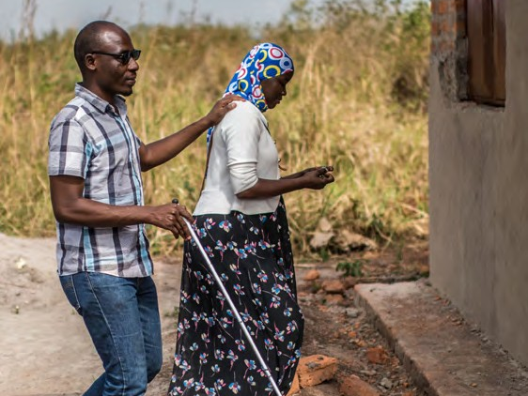
Disability as a human and economic development issue

Slide 6
Why disability is significant
Over one billion persons with disabilities in the world. This corresponds to about 15% of the world’s population, although this varies with age (WHO, 2011 World Report on Disability)
Lower rates of economic and labour market participation equate to higher welfare costs on governments (World Bank 2018 Disability Inclusion Framework)
In middle-income countries, the loss to GDP from the exclusion of women and men with disabilities from the labour market is estimated to be between 3 and 7 percent of GDP (DFID Disability Inclusive Development Strategy)
"Sustainable, equitable progress in the agreed global development agenda cannot be achieved without the inclusion of persons with disabilities."
UN Inter- Agency Support Group, 2011 p 13
Notes:
Note on prevalence:
Number of children (0-14 years) – 5.2%
Number of adults (15-59 years) – 14.2%
Number of older adults (60+ years) – 45.5%

Slide 7

Disability from a rights perspective
Human rights approach (social model)
SOCIETY
Explicit recognition of disabled people as a normal part of all social groups.
Disabled People
Rights based understanding
Focused on identifying barriers
Impairment + Barriers = Disability
Notes:
Note on prevalence:
Number of children (0-14 years) – 5.2%
Number of adults (15-59 years) – 14.2%
Number of older adults (60+ years) – 45.5%

Slide 8
Key development issues
Disabled people are more likely to be socially and economically marginalized as a result of discriminatory attitudes and beliefs
Strong correlation between disability and poverty
Persons with disabilities are less likely to be reached by mainstream anti-poverty campaigns
Persons with disabilities are more likely to be denied their human rights, even when these are guaranteed by national and international laws and progressive legislation.
Lack of design standards for incorporating disability inclusion requirements into government programmes and investments
Notes:
In terms of impact – has significant implications as noted in the WHO World Disability Report:
Disabled children less likely to attend school or to receive adequate, accessible education
Means disabled young people are less prepared for independence – find it more difficult to gain employment, start business or to earn an income
Less access to comprehensive sexuality education; to vital health interventions (such as vaccinations); to citizen accountability mechanism etc....
Their specific health needs more likely to be overlooked – lack of habilitation/rehabilitation programmes; AT; CBR etc

Slide 9
 | UK | Uganda | Bangladesh | Kenya | Brazil
Disability prevalence | 21% | 6.5% | 1.4% | 3.5% | 23.9%
Unemployment rate (15-24 years) | 9% disabled 3.8% non-disabled | 22% disabled 16% non-disabled | 9% disabled 7% non-disabled | 16% disabled 16% non-disabled | 54% disabled (any age) 44% non-disabled
Proportion below national poverty line | 30% disabled 19% non- disabled | 57% disabled 45% non-disabled | 28% disabled 24% non-disabled | 67% disabled 52% non-disabled | Info. not found
Disability in figures
Notes:
Data sources:
UK – 2015/16 Family Resource Survey + Papworth Trust (2018), Facts and Figures 2018: Disability in the United Kingdom. Using Functional limitations questions.
Uganda – 2016 Census Utilised WGQs
Bangladesh – 2011 Census. Utilised a binary self declaration – do you have a disability?
Kenya – 2009 Census. Utilised a binary self declaration – do you have a disability?
Brazil – 2010 Census. Utilised WGQs
See https://www.disabilitydataportal.com/ for more information on disability data

Slide 10

Disability and the SDGs
Sustainable development goals (SDGs) explicitly reference persons with disabilities in targets and indicators
Disaggregation of data by disability is encouraged across all SDGs (follow up and review)
Goals with references to disability
Notes:
Ensure the presenter reads out the Key SDG areas
Also important to note that there are a lot of opportunities for working inclusively across all SDGs
Mention too that the World Bank is committed to doing more with its disability inclusion and accountability- http://documents.worldbank.org/curated/en/437451528442789278/pdf/126977-WP-PUBLIC-DisabilityInclusionAccountabilitydigital.pdf

Slide 11
Key developments around disability inclusion
UK is in process of developing a new UK National Disability Strategy in 2020 after widespread consultation – likely to have an international angle.
The World Bank launched its disability inclusion and accountability framework in 2018 including ambitious targets for inclusive projects, including around transport and urban
World Economic Forum (2019) made strong economic case for disability inclusion and stressed the need for a global standard in workplace disability equality.
DFID’s Economic Development Strategy commits DFID and ODA spending departments to focus on the poorest and most marginalised people - women and girls and people with disabilities are highlighted in particular

Slide 12
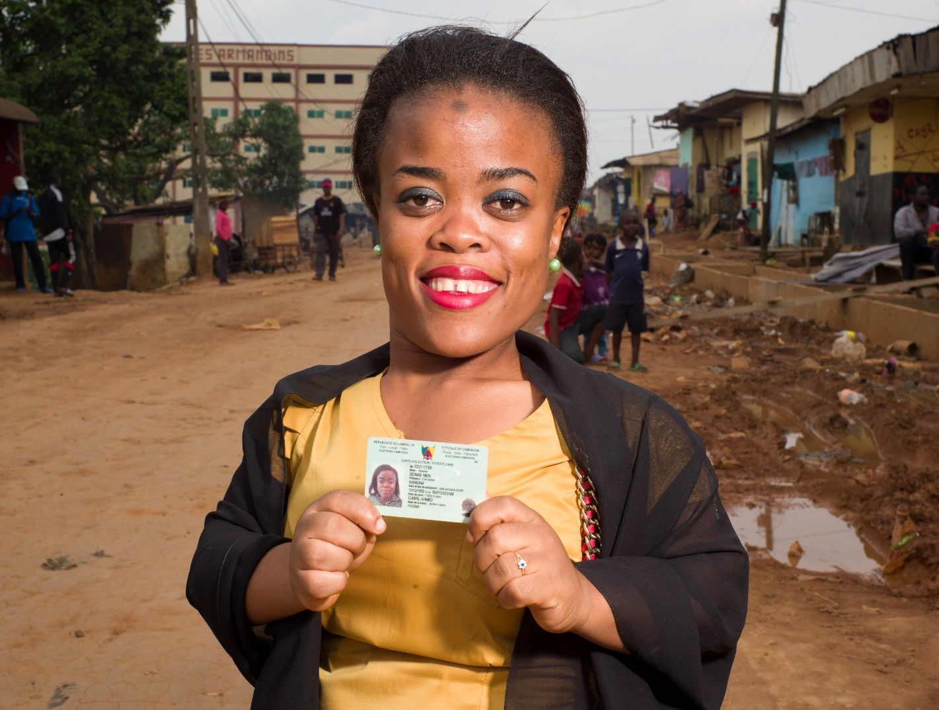
Implementing disability equitable programmes

Slide 13
Disability is a sticky problem in DFID development programming
  Invisibility of people with disabilities in data that exists;
  Disability from a rights perspective is still poorly understood in mainstream development;
  Homogenisation of disabled people’s experiences.
General lack of documented experiences in relation to disability inclusion (knowledge gap)
Underestimation of the impact disability has on development outcomes at all levels
Notes:
lack power/voice of disabled people
assumed barrier is disability
no universal acceptance that disability impacts development outcomes
data gaps

Slide 14
Private sector engagement
1 billion disabled people globally
Significant source of talent for employment; development of new products/services
Consumers (valued at $1.2tn per year with families increases to $8.1tn)
Potential for increasing private sector output, boosting economic production, creativity and innovation
Business case for disabled people as employees
Myths: loss in productivity; financial implications...
  Accenture (2018) study showed companies employing disabled people were above average in profitability and value creation
Disabled people as good problem solvers, adaptable
Lower turnover (48% less)
Inclusive workplaces work for everyone
Reputational benefits
From Disability Hub Europe (2019) Making the future of work inclusive of people with disabilities
Notes:
Useful information from ‘Making the future of work inclusive of people with disabilities’ by Disability Hub Europe,

Slide 15
Useful Inclusion Framework
Compliant
Programmes address basic needs and vulnerabilities
Empowering
Programmes build assets, capabilities and opportunities
Transformative
Programmes address unequal power relations and seek institutional and social change
Notes:
http://icedfacility.org/
Infrastructure and Cities for Economic Development

Slide 16
Inclusive infrastructure entry points
Sector | Compliant | Empowering | Transformative
Transport | Accessible information, through SMS / apps Boarding devices, allocated seating, wheelchair spaces, access to/from transport hubs | Design consultation with disabled people New transport services utlilise UD to link economic + residential hubs Specialist services for more severe impairments | Disability inclusive design in policy frameworks enforced at local level City transport networks designed to ensure disabled people have equitable access Staff can evaluate effectiveness of accessibility and can address as needed
Energy | Accessible energy promotion / sales information | All energy services are accessible – tariffs, billing, service announcements. Installed services accessible - meters and wiring in HHs | Engage disabled people in planning and decision making around market-based energy solutions Consider affordability of energy solutions for HHs headed by disabled people
Notes:
http://icedfacility.org/
Infrastructure and Cities for Economic Development

Slide 17
Opportunities in technology
Potential enabler in areas like education, employment, civic participation + financial inclusion
Technology that is accessible and allows for adaptability, customisation and individualisation can reach everyone

Slide 18
Inclusive design
Assistive technology
Maintain / improve functionality
~ 10% people globally have access
Accessible technology
Designed for multiple users
Accessibility controls, voice recognition, change text size/colour
Free to use software – e.g. Google search showing wheelchair accessible routes in trial cities
Create enabling environment
Update governance and regulatory systems
Remove barriers to trade that affect availability and affordability (ATs)
Promote Universal Design in new products and services

Slide 19
Practical advice – things to prioritise
Ensure a rights-based approach to inclusion – disability = impairment + barriers; the CRPD principles as a useful guide
Consult people with disabilities and disabled people’s organisations (DPOs)
data and evidence – data disaggregation and indicators, disability inclusion policy marker
Learn from UK Aid’s approach to gender – lots of parallels!
Notes:
Getting disability into business case development very important. That is more than just filling out the section on disability though – if we adopt a barriers approach it is possible to add potential barriers information into the problems section / identifying key issues the programme will address / evidence around key issues (like in SRH for example considering the issues faced by young women with disabilities).
How partners understand disability is really important – often find that they do not. Issues in humanitarian contexts for example where programme has intention to include but partners on the ground had no capacity. Important to check this out (pre-market engagement can raise this)
Ensure there are resources built in to add capacity around inclusion. Through training for example
Have to see disability as an indicator – want to see parity indicators set. If doing SRH intervention then we need to see how many young people with disabilities are accessing the services for example.

Slide 20

Summary and where to go for further support

Slide 21
Useful websites for resources
Business Disability Forum
Zero Project
Disability Hub
Based in the UK this membership organisations brings together business people with leading disability actors and government to improve business and consumer accessibility.
Global programme which finds and shares models that help improve the lives and legal rights of disabled people. It has experience and information linked to employment from around the world.
European network focused on promoting inclusive and sustainable businesses. They have a lot of resources linked to employment, inclusive workplaces, supply chain considerations and many other key topics.
ILO Global Business and Disability Network
Employer-led initiative supported by ILO which is providing help and resources which promote the inclusion of disabled people in workplaces around the world.

Slide 22
What the Disability Inclusion Helpdesk offers
The Helpdesk is run by Social Development Direct alongside the DID programme consortium.
We have a pool of over 70 disability inclusion experts together with an in-house team of helpdesk researchers.
We maintain flexibility to respond to requests
We can provide:
  rapid turnaround desk-based queries – evidence reviews, mappings etc.
  expert input into programme design, policy, data and evidence

Slide 23
Examples of recent queries
Rapid evidence review on the impact of training for people with disabilities
Call an expert on designing a new investment climate programme
Currently development disability awareness training for UK Prosperity Fund gender and inclusion champions
Useful resources on the ICED website: http://icedfacility.org/disability/

Slide 24
Find out more about the Helpdesk
For more info on our services, have a look at our flyer
Our recent queries are published on gov.uk
And read our quarterly evidence digest a roundup of the latest evidence, policy news and updates from DFID-funded programmes
Contact the Helpdesk using this email address: enquiries@disabilityinclusion.org.uk

Slide 25
Thank you
If you would like to
find out more visit
www.sddirect.co.uk

